Slide 2
Important Point

Slide 3
Business Problem
“You take away our top 20 employees and we become a mediocre company.”
-Bill Gates

Slide 4
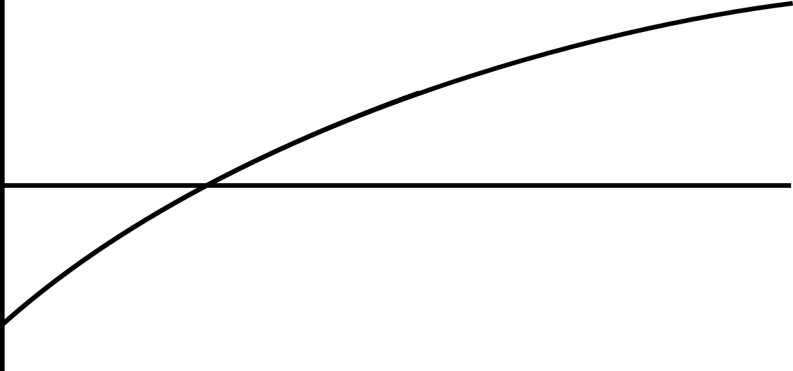
White Background

